Slide 1
Air Pollution Capstone
DS
Geoffrey Leigh

Slide 2
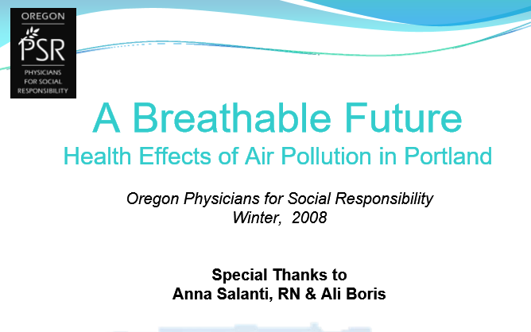
Competitors Presentation #1

Slide 3
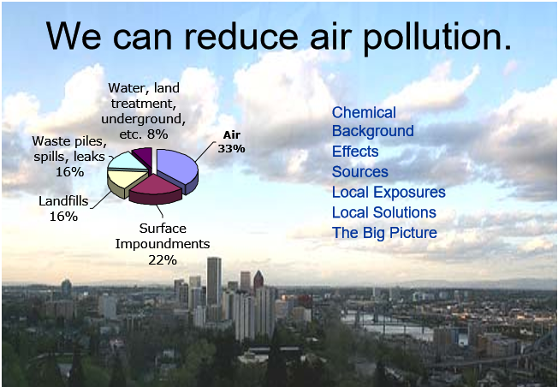
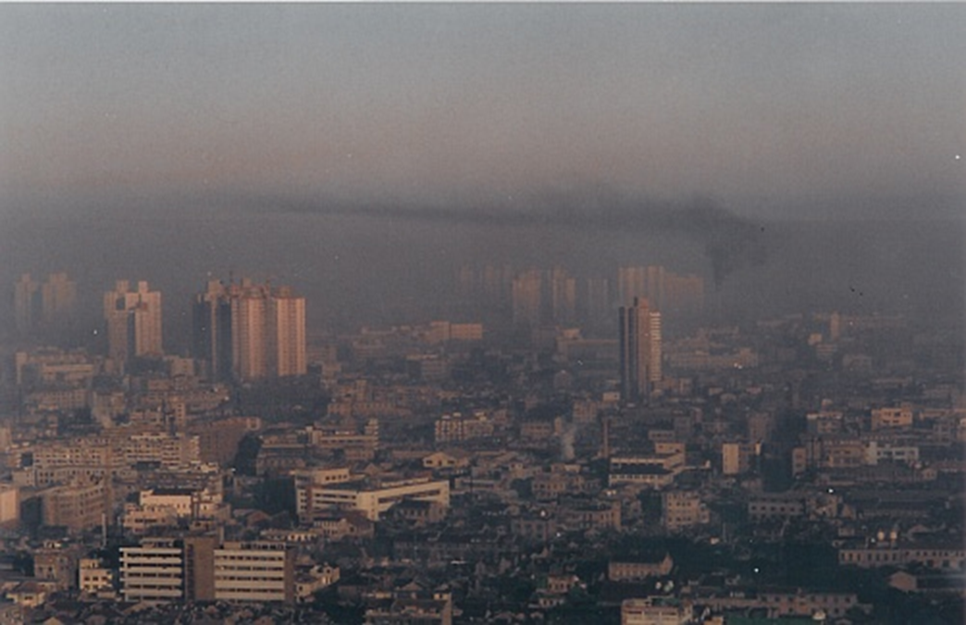
Will be more surgical and focus on air pollution within a particular area.

Slide 4
Capstone: Air Pollution Focus
The natural atmosphere
Outdoor pollutants and their sources
Indoor air pollution
Health effects of air pollution
Measurement of particle pollution
Climate change

Slide 5
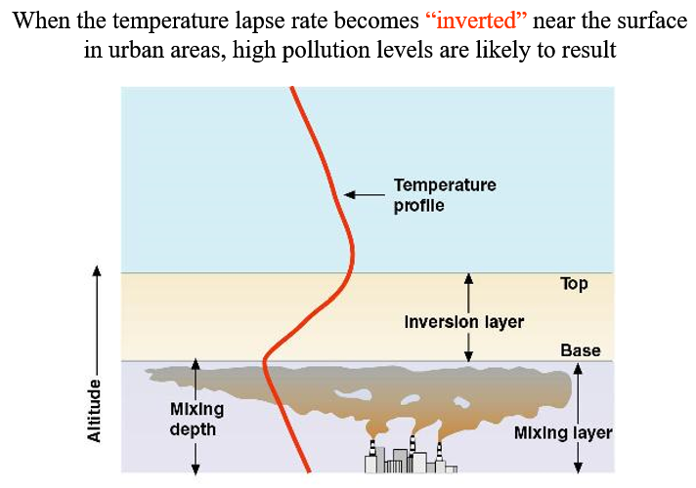
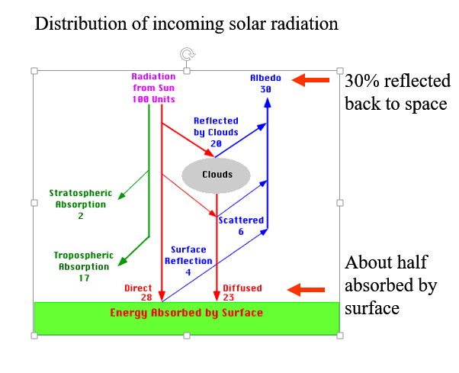
They focus on Solar Radiation while I will focus on Temperature and Levels of the atmosphere.

Slide 6
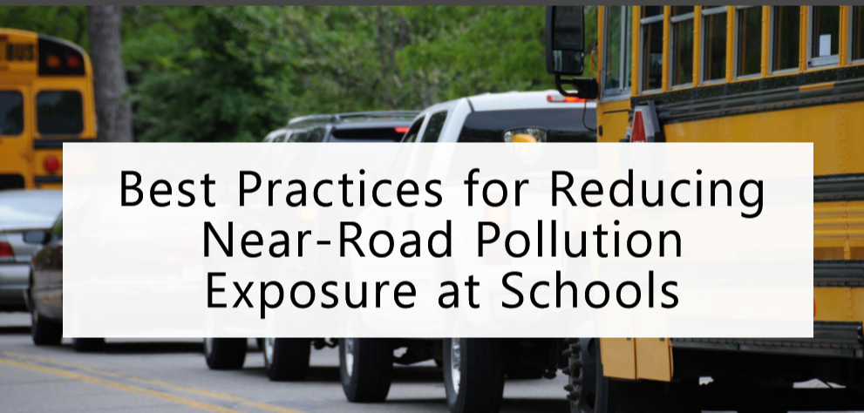
Competitors Presentation #2

Slide 7
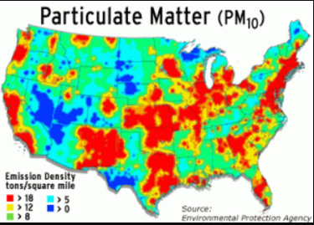
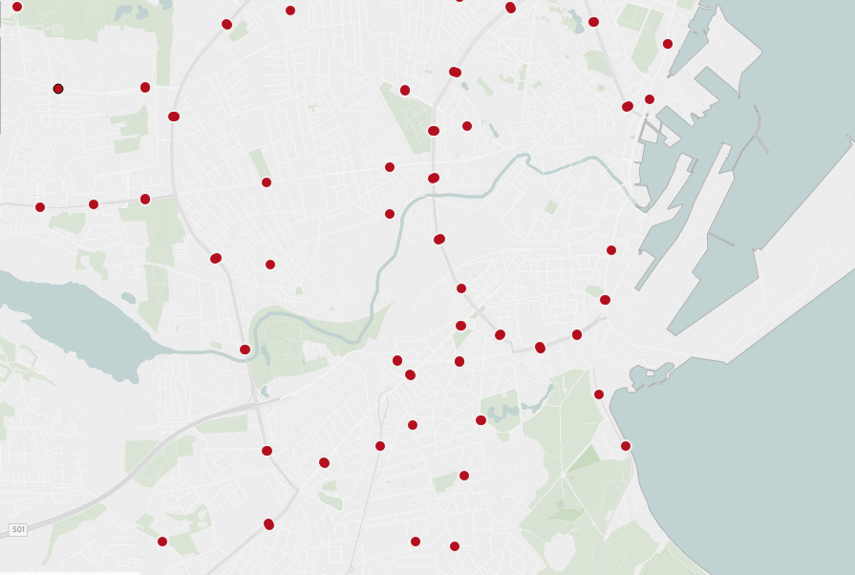
Competitor are focused on a broad area in the US while I will focus on a specific city

Slide 8
Similar to other studies but not as specific
Carbon monoxide (yes)
Sulfur dioxide (yes)
Nitrogen dioxide (yes)
Volatile organics (NO)
Ozone (NO)
Particulate matter (some)
Sulfates, nitrates, organics, elemental carbon, lead and other metals

Slide 9
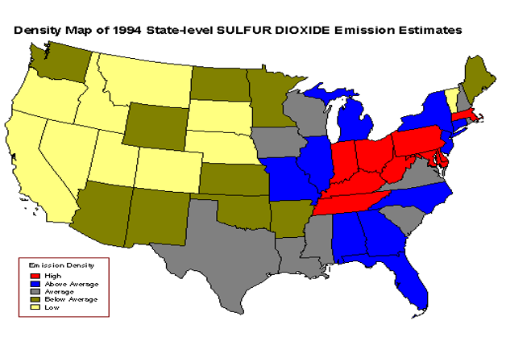

Slide 10
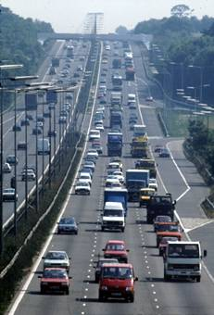
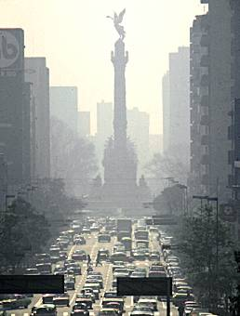
Transportation related causes of air pollution

Slide 11
Passenger car
emissions ratings
HC
CO
Nx
Transitional Low-Emission Vehicle(TLEV)
50%
NR
NR
Low-Emission Vehicle (LEV)
70%
NR
50%
Ultra-Low-Emission Vehicle (ULEV)
85%
50%
50%
Super-Ultra-Low-Emission Vehicle (SULEV)
96%
70%
95%
Zero-Emission Vehicles (ZEV)
100%
100%
100%

Slide 12
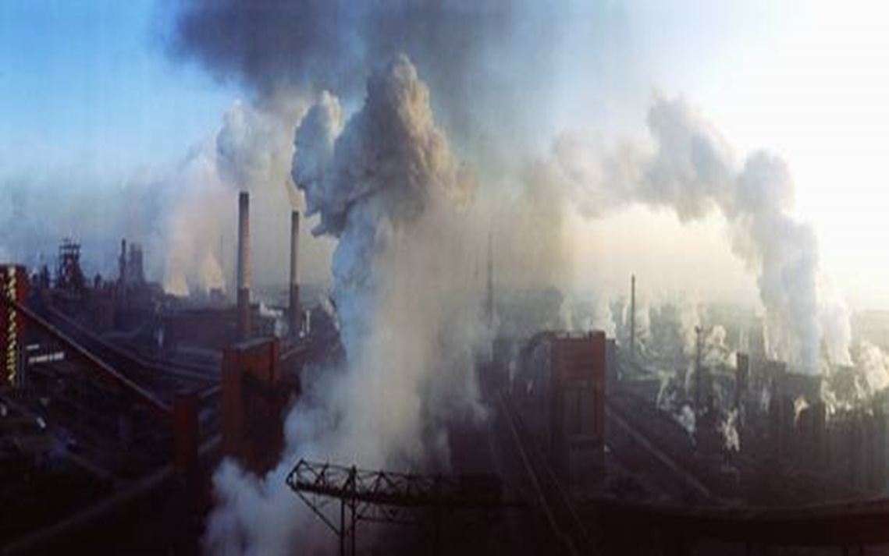
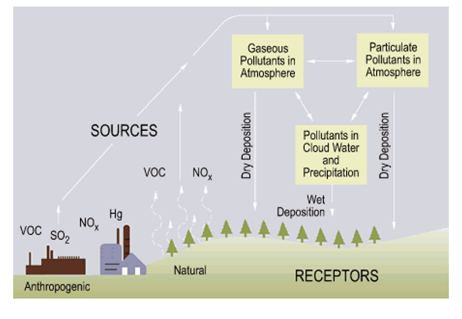
Competitors focus on specific emissions of cars while I will focus on roads/highways and industrial plants

Slide 13
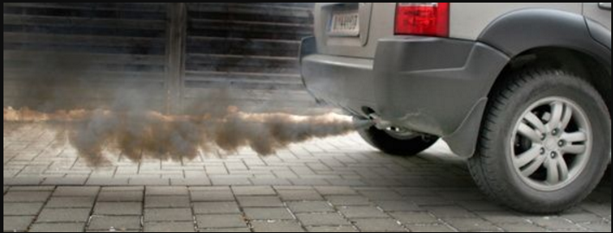
Using data stations along the highways and roads.

Slide 14
Nitrogen Dioxide – NO₂
Formed by oxidation of NO, which is produced with high temperature combustion (NO₂ is a secondary pollutant)
Oxidant that can irritate the lungs and hinder host defense
A key precursor of ozone formation
Emissions reductions by engine redesign and use of catalytic converters

Slide 15
Sulfur Dioxide – SO₂
Primary pollutant, emitted by combustion of fuels containing sulfur; also metal smelting
Irritates upper respiratory tract
Converted in atmosphere to acid sulfates
Emissions reductions by building taller smoke stacks, installing scrubbers, or by reducing sulfur content of fuel being burned

Slide 16
Carbon Monoxide - CO
Colorless, odorless gas
Primary pollutant, emitted by incomplete combustion of biomass or fossil fuels
Binds strongly with hemoglobin, displacing oxygen
Emissions reduction by higher temperature combustion and use of catalytic converters on motor vehicles

Slide 17
Particulate Matter - PM
Products of combustion, atmospheric reactions, and mechanical processes
Wide range of particle sizes
Wide range of physical/chemical properties
Wide range of health impacts, including premature death
Control by filtration, electrostatic precipitation, and reduction of precursor gases

Slide 18
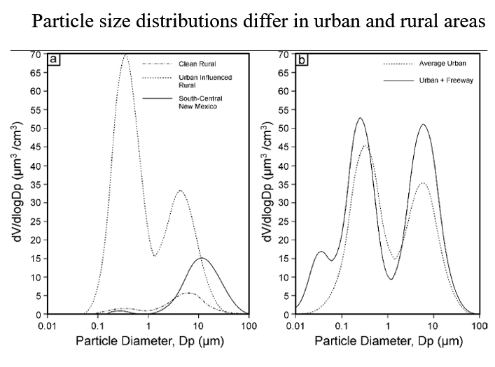
Competitors focus on Urban and Rural

Slide 19
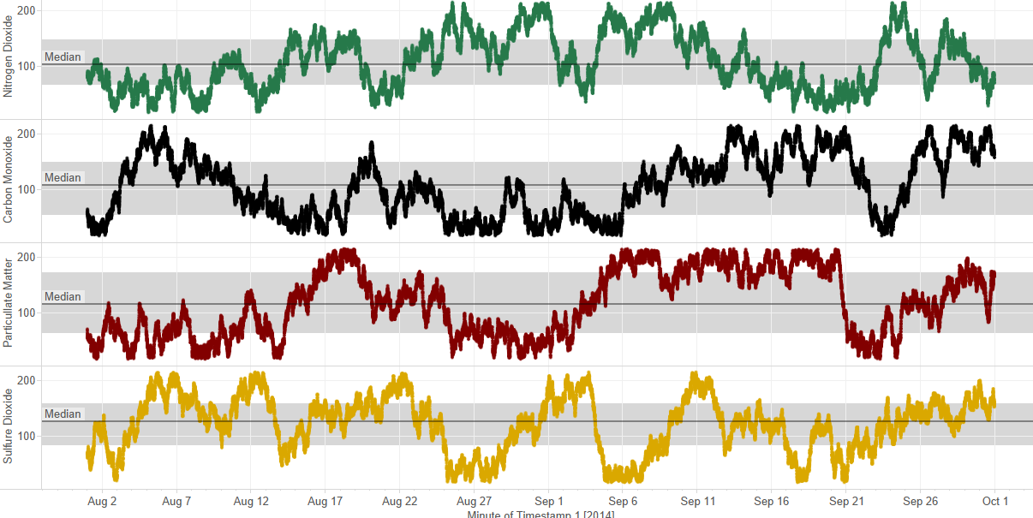
Our study will be in an urban setting

Slide 20
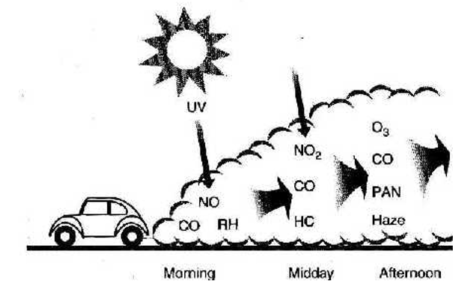
Our study will focus on time series analysis.

Slide 21
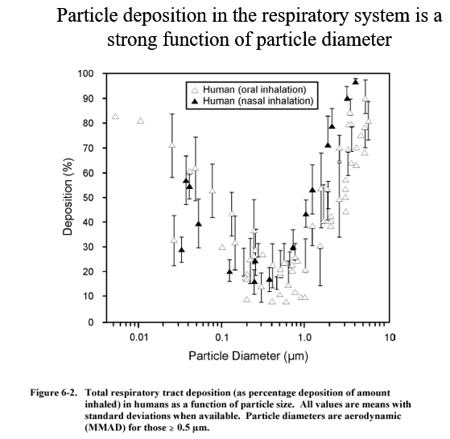
Competitor focus on health effect of pollution

Slide 22
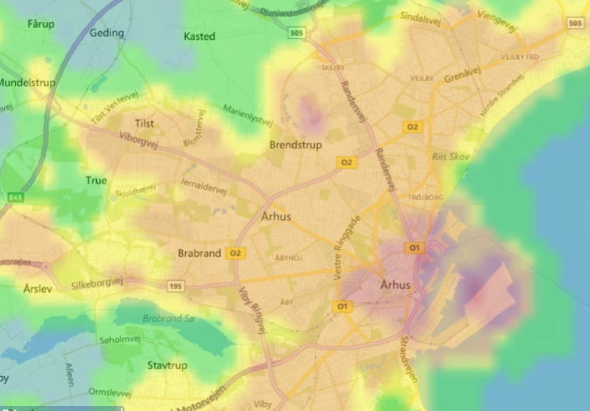
Our study will focus on the area where is the pollutant is most prevalent

Slide 23
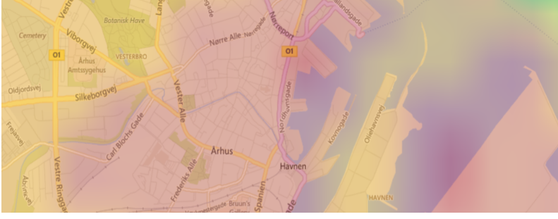
Investigate which routes and time where levels are high

